Slide 1





SUDIA ARIBIA
PREDICTIVE MODELING FOR CONDO PRICE TRENDS IN SAUDI ARABIA

Slide 2


CONTENT
01
02
03
04
About Us
Introduction and Hypothesis
web scraping
Data Overview
05
06
07
08
Data Cleaning
Exploratory Data Analysis
Machine Learning Model
Conclusion

Slide 3




ABOUT US
م. هاجر حسين القحطاني
ماجستير علوم بيانات
جامعة الملك خالد
الدكتور: أيمن قحمش

Slide 4




INTRODUCTION
Hypothesis: The price of Condo in Saudi Arabia is influenced by various factors such as the location, number of beds, number of bedrooms, and the overall rating of the place.
Overview of the predictive modeling objective.
Introduction to the dataset used in our analysis.
3.Key steps in data preprocessing and exploration.
4.Highlights from our predictive modeling approach.
5.Evaluation of different models for condo price prediction.
6.implications and potential applications of our findings.

Slide 5




2: WEB SCRAPING
Explain the data source (Airbnb in Saudi Arabia).
- List and describe relevant columns for condo price prediction (e.g., url, name, header, beds, bedrooms, date_range, price, rating).
BeautifulSoup
web scraping
Project Initiation

Slide 6






DATA OVERVIEW:
The dataset comprises seven columns:
01
02
03
num comments
beds
location
number of beds in the department
the location of the codo
numbers of comment in the review
04
05
06
BORCELLE
price
rating
bedrooms
the price of the codo
the rating of the review
number of bein the department

Slide 7


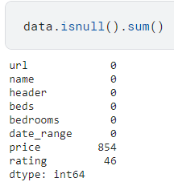
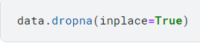

DATA CLEANING AND PREPROCESSING:
01
Handling Missing Values:
The dataset had missing values in the 'price' and 'rating' columns, which were addressed by dropping rows with null values.

Slide 8
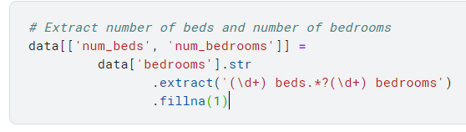
DATA CLEANING AND PREPROCESSING:
02
Feature Extraction
New features, 'num_beds' and 'num_bedrooms,' were extracted from the 'bedrooms' column to provide additional insights.

Slide 9
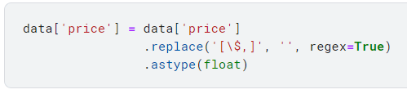
DATA CLEANING AND PREPROCESSING:
02
Fixing Price Values:
Dollar signs were removed from the 'price' column, converting it to a float type for analysis.

Slide 10
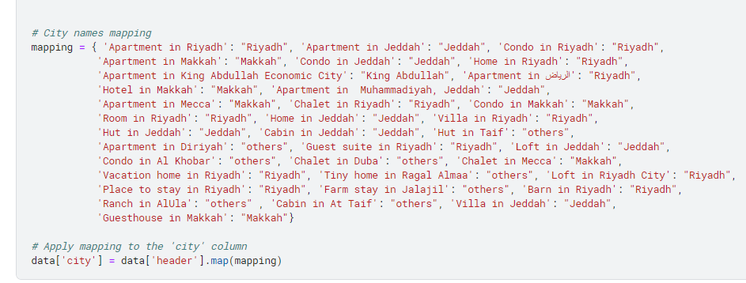
DATA CLEANING AND PREPROCESSING:
02
City Mapping: The 'header' column was mapped to 'city' for better analysis.

Slide 11


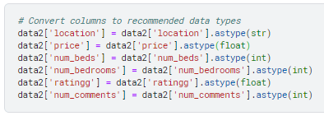

COLUMNS TYPE
Once you have converted the data types, you can then enter the data into the model.
The model will then be able to learn the relationships between the data and make more accurate predictions.

Slide 12
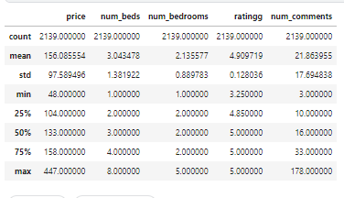
STATISTCS
Once you have converted the data types, you can then enter the data into the model.
The model will then be able to learn the relationships between the data and make more accurate predictions.

Slide 13

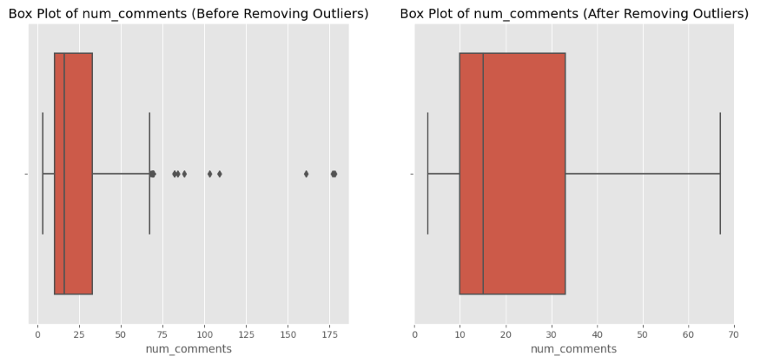
EXPLORATORY DATA ANALYSIS (EDA):
Outliers
Remove outliers in the num_comments

Slide 14
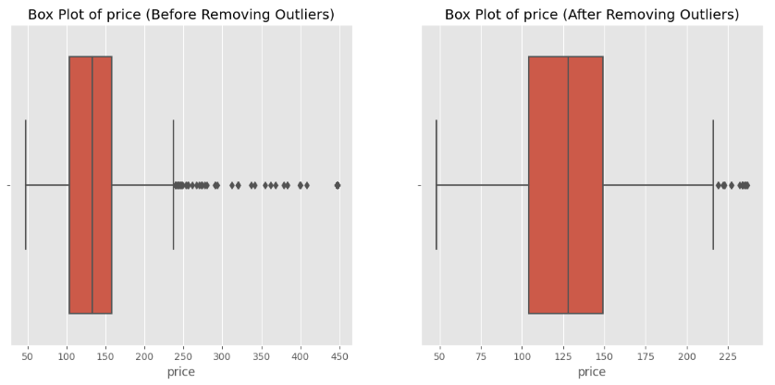
EXPLORATORY DATA ANALYSIS (EDA):
Outliers
Remove outliers in the price

Slide 15

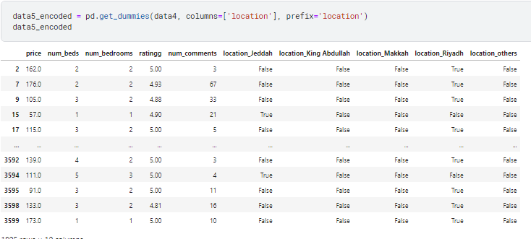

ENCODE THE COLUMNS
enncode the locations value by the get dummies function
Dani Martinez

Slide 16
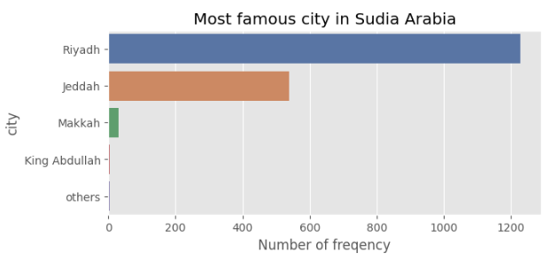
EXPLORATORY DATA ANALYSIS (EDA):
City Distribution:
Riyadh emerged as the most frequent city in the dataset, influencing the overall distribution.

Slide 17
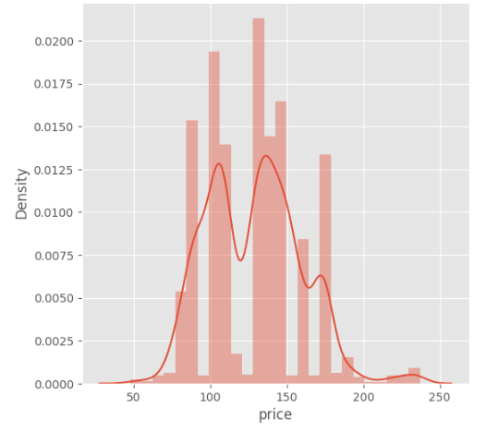
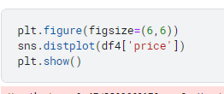
EXPLORATORY DATA ANALYSIS (EDA):
Price Distribution:
The distribution of house pricing indicated a variety of price ranges across the dataset.

Slide 18
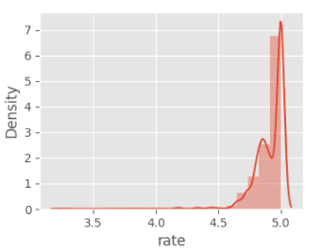
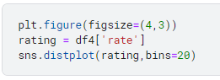
EXPLORATORY DATA ANALYSIS (EDA):
Rating Distribution:
The majority of places had ratings between 4.5 and 5, with lower ratings being rare.

Slide 19
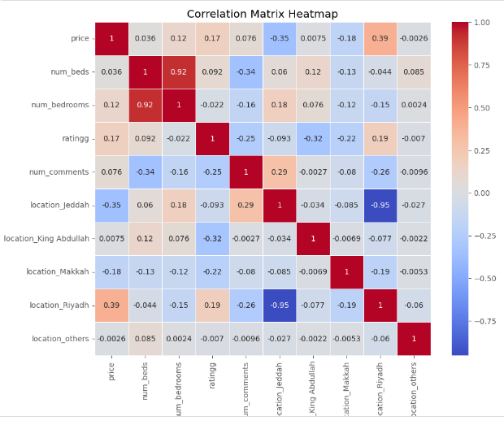
EXPLORATORY DATA ANALYSIS (EDA):
Correlation Heatmap:
A heatmap was used to visualize the correlation between different features.

Slide 20
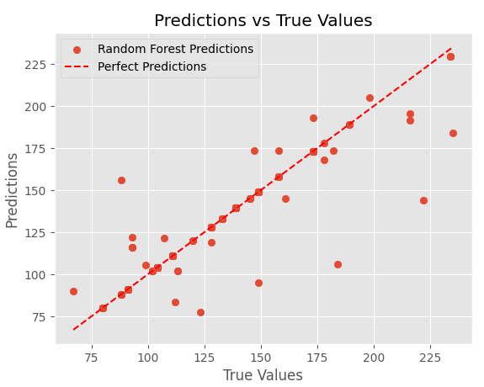
MACHINE LEARNING MODELS:
The dataset was split into training and testing sets for machine learning model evaluation. Several regression models, including Linear Regression, K-Nearest Neighbors, Decision Tree, Random Forest, and XGBoost, were applied to predict departmental prices.
Linear Regression:
Mean Squared Error: 635.47
R^2 Score: 0.37
K-Nearest Neighbors:
Mean Squared Error: 158.35
R^2 Score: 0.84
Decision Tree:
Mean Squared Error: 144.35
R^2 Score: 0.86
Random Forest:
Mean Squared Error: 81.49
R^2 Score: 0.92
XGBoost:
Mean Squared Error: 114.75
R^2 Score: 0.89
In this case, Random Forest has the lowest Mean Squared Error and the highest R^2 Score, suggesting that it performs better than the other models based on the given metrics.

Slide 21
The results of our regression models support our hypothesis. The number of bedrooms, the number of beds, and the location significantly influence condo prices in Saudi Arabia. The Random Forest model, which takes into account these features, provided the most accurate predictions. Adjustments and enhancements to the model, considering outliers and additional features, could further improve its performance.
CONCLUSION:

